Slide 1
Team-34

Slide 2




CONTENT OF THE PRESENTATION
PROBLEM STATEMENT
EXPLORATORY DATA ANALYSIS
FEATURE ENGINEERING
MODELS AND PREDICTIONS
Notes:
Good Afternoon Judges, To keep you align with the agenda of this presentation We will first start with a big picture of what we are going to present during the course of our presentation,. We will start with our understanding of the problem statement provided, along with some traditional exploratory data analysis. Then we will explain how we have developed intelligent features and removed outliers to help our models learn better. We then move on to explain different models we have applied and the results which we have got on the validation set. Finally we will discuss the best model . So let us begin.

Slide 3





PROBLEM STATEMENT
MAXIMIZING REVENUE BY EFFICIENTLY PREDICTING POPULARITY OF SONGS
TASK 1
Classification of Songs into 5 predefined
popularity levels
TASK 2
Calculating the Maximum Revenue generated by Bidding according to the Model
Notes:
Ps define

Slide 4
PROBLEM STATEMENT
The target variable to predict is “popularity”, has 5 categories: ‘Very high’, ‘high’, ‘average’, ‘low’, ‘very low’. For each category, there is an initial bid price and expected revenue collections (in $10K ) as shown in table.
Popularity | Bid Price | Expected Revenue
Very High | 5 | 10
High | 4 | 8
Average | 3 | 6
Low | 2 | 4
Very Low | 1 | 2
Bidding Criteria
For the wrong prediction, bidding will be successful only if we bid a less
popular music track at the cost of a more popular music track, vice versa is not possible.

Slide 5

EXPLORATORY DATA ANALYSIS
GETTING INSIGHTS ABOUT THE GIVEN DATASET
Notes:
So, now let’s talk about EDA that is the part where we get the insights from the data.

Slide 6
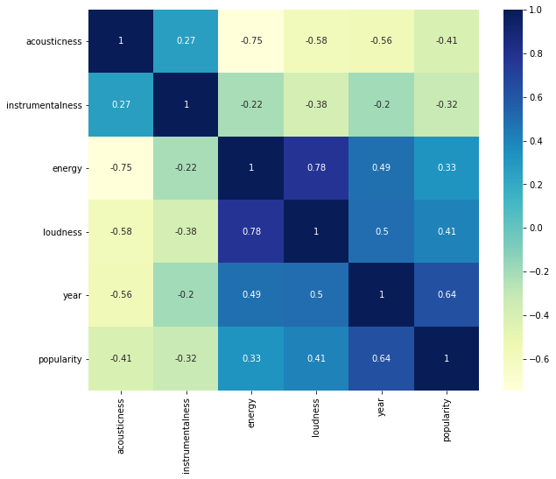
EXPLORATORY DATA ANALYSIS
CORRELATION
The Louder the sound is, the more energy the sound wave contains. The correlation we found out between loudness and energy is pretty high, which validates the above mentioned fact. The popularity of songs increases as we move ahead in time indicating that people prefer new songs to old ones and also there is an overall increase in the number of people listening to music.
Notes:
So looking at the features we sort of get this intuition that the louder the sound is the more energy the sound wave has. So we plotted the correlation matrix the indeed it was. loudness and energy were highly correlated, 0.78 was the correlation between them to be more specific. Also we know from the fact that in general newer songs tend to be more popular during a new year release, and we found out that the songs which were released in the month of january and to be more specific on the 1st of january were more popular. also there was an overall increase in the number of people listening to music in the course of time.

Slide 7
EXPLORATORY DATA ANALYSIS
 | acousticness | instrumentalness | energy | loudness | year | popularity
mean | 0.430578 | 0.149321 | 0.522129 | -10.668687 | 1984.517298 | 2.491453
std | 0.366893 | 0.297954 | 0.262482 | 5.506888 | 25.911998 | 1.176612
min | 0.000001 | 0.000000 | 0.000020 | -43.738000 | 1920.000000 | 1.000000
25% | 0.058950 | 0.000000 | 0.303000 | -13.656000 | 1966.000000 | 1.000000
50% | 0.354000 | 0.000115 | 0.534000 | -9.584000 | 1987.000000 | 2.000000
75% | 0.805000 | 0.055650 | 0.739000 | -6.571500 | 2008.000000 | 3.000000
max | 0.996000 | 1.000000 | 1.000000 | 1.006000 | 2021.000000 | 5.000000
SUMMARY STATISTICS
The data provided consists of different audio features and their release dates with 12227 unique ids. There is a measure of loudness score for each sample which is useful for comparing relative loudness of the tracks.
Notes:
Also 75% of the values of Instrumentalness are less than 0.05 and the maximum value is 1 which gives the clear indication of outliers in the dataset. Looking at the summary statistics of energy, we saw that it is well distributed as its quartiles

Slide 8
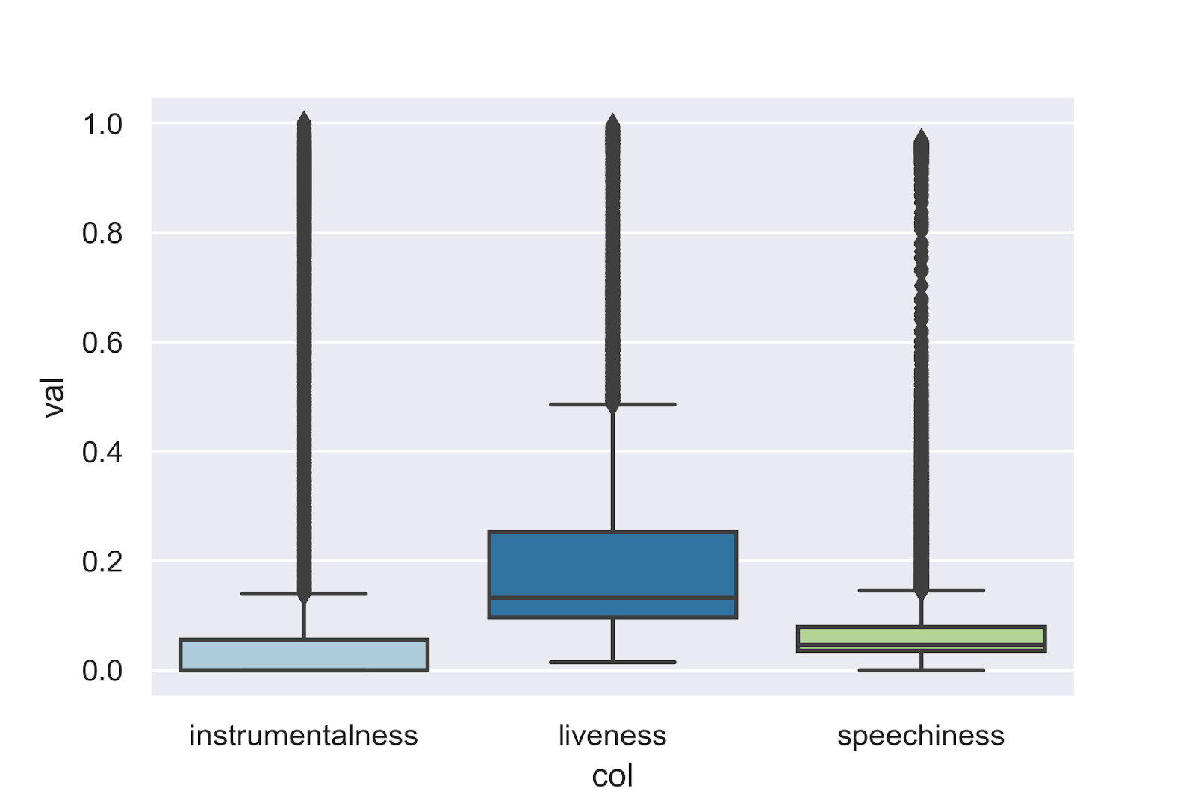
EXPLORATORY DATA ANALYSIS
ANOMALY DETECTION AND REPLACEMENT
These are the boxplots of features having outliers more than 6%.
Since there are a significant number of outliers so we decided to treat them with the help of 3-sigma rule. A threshold for upper limit and lower limit were set and the values greater or lower than them were made equal to the threshold respectively
Feature | % of outliers
Instrumentalness | 21.6324
Liveness | 7.0745
Speechiness | 13.92819
Notes:
these are boxplots of the features which had more than 6% outliers. Since the outliers were large in number we tried to treat these features with the help of 3-sigma rule. Thresholds for upper limit and lower limit were also set and the values greater or less than them were made equal to the respective thresholds.

Slide 9

FEATURE ENGINEERING
New Features introduced to increase the accuracy of model:
Release Day
Release Month
Notes:
WHAT EXACTLY SENTIMENT ANALYSIS DEALS WITH ?
Classifying whether a piece of text provides a positive, negative or neutral

Slide 10
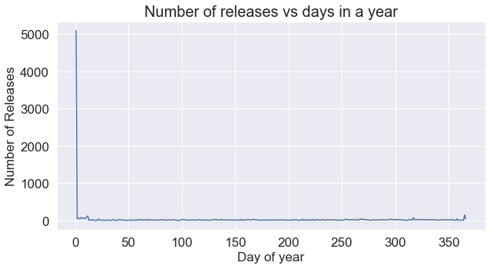
FEATURE ENGINEERING
Release Day
Most of the songs were released on a single day.
Contains the Day of Year on which the song was released.

Slide 11
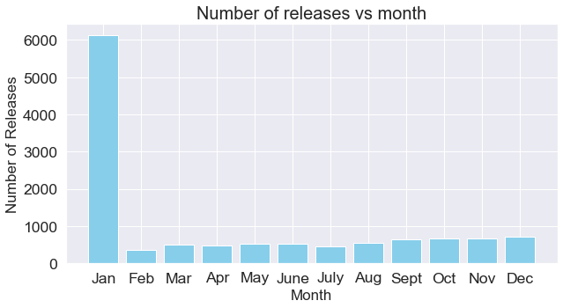
FEATURE ENGINEERING
Release Month
Most of the songs were released in a particular month.
Contains the month number of the song.

Slide 12
MODELS AND PREDICTIONS
MODELS USED
XGBOOST
RANDOM FOREST

Slide 13
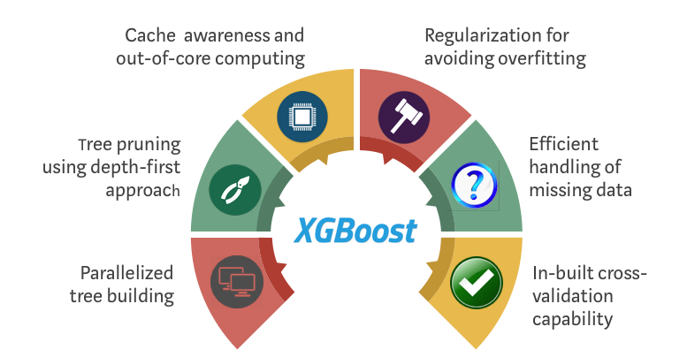
MODELS
XGBOOST
Xgboost is a decision-tree-based ensemble Machine Learning algorithm that uses a gradient boosting framework.
WHY XGBOOST?
1. Execution Speed
2. Flexibility in setting on objective function
Maximum possible bid on test data:
$ 9891
Notes:
Theory
XGBoost is an optimized distributed gradient boosting library designed to be highly efficient, flexible and portable. It implements machine learning algorithms under the Gradient Boosting framework. It is an approach where new models are created that predict the residuals or errors of prior models and then added together to make the final prediction. It is called gradient boosting because it uses a gradient descent algorithm to minimize the loss when adding new models.
Why XGBoost?
The two reasons to use XGBoost are also the two goals of the project:
Execution Speed: It is really fast when compared to other implementations of gradient boosting.
Model Performance: It dominates structured or tabular datasets on classification and regression predictive modelling problems.
Finally, the evidence is that it is the go-to algorithm for competition winners on the Kaggle competitive data science platform.
we implemented ML models to check if it could possibly improve the results. XG Boost was chosen mainly because of its higher execution speed.
It calculates errors and residuals of a base model and uses them to keep building better models, until it can reduce the loss as much as possible.
the results obtained were best compared to other traditional classification models ,

Slide 14

MODELS
Random Forest
RANDOM FOREST CLASSIFIER
Random Forest consist of large number of individual decision trees that operates as an ensemble.
Ensemble Cross-Validation
Class Weight
WHY RANDOM FOREST ?
1. Robust to overfitting.
2. Intuitively classify data points.

Slide 15
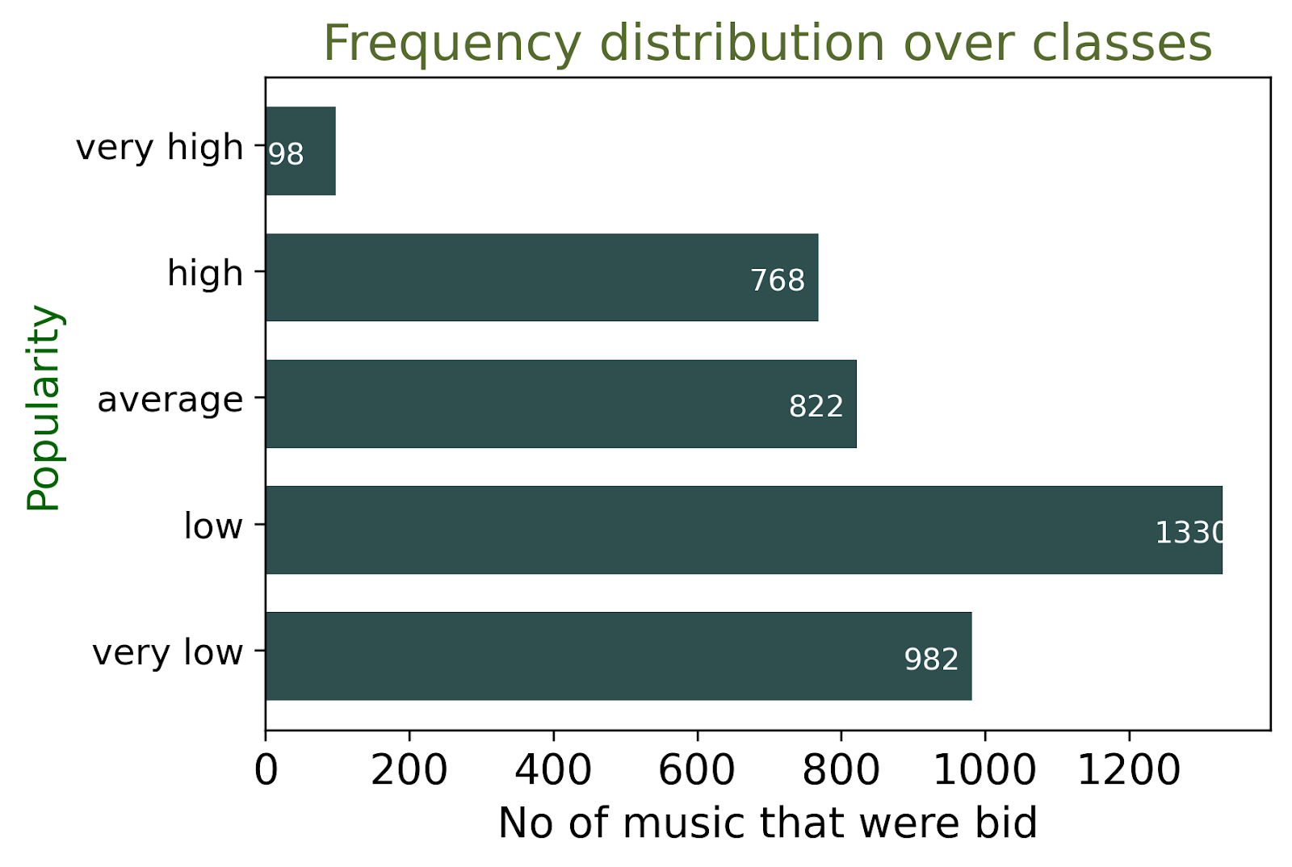
PREDICTIONS
Cross-Validation
Accuracy ~84.5%
Successful bidding cost 9259 generated revenue of 17789
F1 score 63.0%
Test
Predicted 2.4% music in very high class.

Slide 16
CONCLUSION
We ran the dataset on two models(XgBoost and Random Forest) for obtaining the performance.
On the cross-validation set with ~4000 music we obtained a revenue of 14198 and 17798 in XgBoost and Random Forest respectively.
Tree based methods outperformed other models due high imbalance in classes.

Slide 17
THANK YOU

Slide 18
BACKUP SLIDES
Correlation Heatmap
Data Description
Boxplots of features
Histogram of features
Classification Report of Random Forest

Slide 19
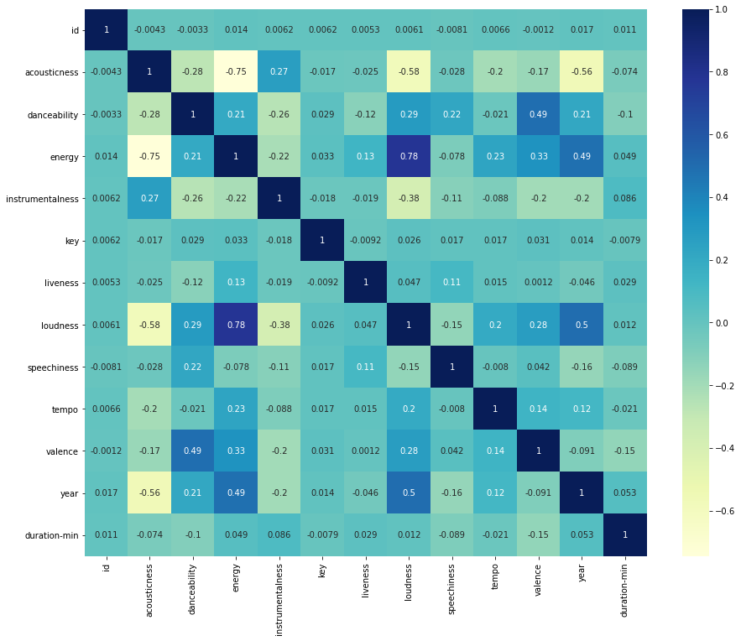
1. Correlation Heatmap

Slide 20
2. Data Description
Danceability describes how suitable a track is for dancing based on a combination of musical elements including tempo, rhythm stability, beat strength, and overall regularity.
Liveness score detects the presence of an audience in the recording. Higher liveness values represent an increased probability that the track was performed live.
Speechiness detects the presence of spoken words in a track.
Instrumentalness predicts whether a track contains no vocals like (“Ooh” and “aah”).
Loudness score for each sample which is useful for comparing relative loudness of the tracks.
Mode Indicates the modality (major or minor) of a track, the type of scale from which its melodic content is derived. Major is represented by 1 and minor is 0.
Key feature is Integers map to pitches using standard pitch class notation.
Tempo feature is a measure of BPM(beats per minute ) which shows the speed or pace of sample audio.
Acousticness is a confidence measure from 0.0 to 1.0 of whether the track is acoustic.
Valence describes the musical positiveness conveyed by a track. Tracks with high valence sound more positive (e.g. happy, cheerful, euphoric), while tracks with low valence sound more negative (e.g. sad, depressed, angry).
Explicit track is one that has curse words or language or art that is sexual, violent, or offensive in nature.

Slide 21
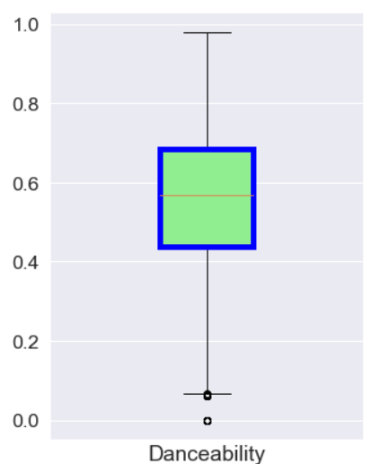
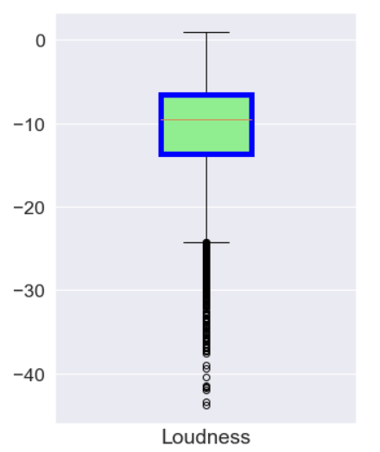
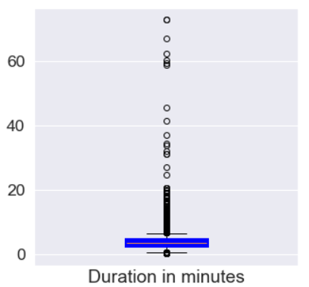
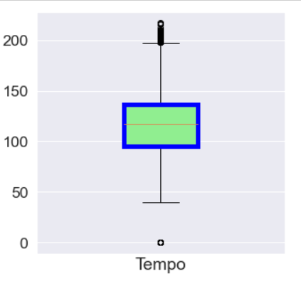
3. Boxplots of features

Slide 22
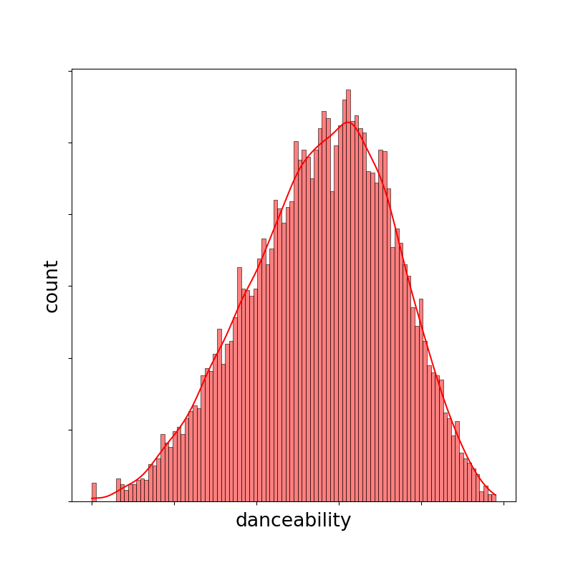
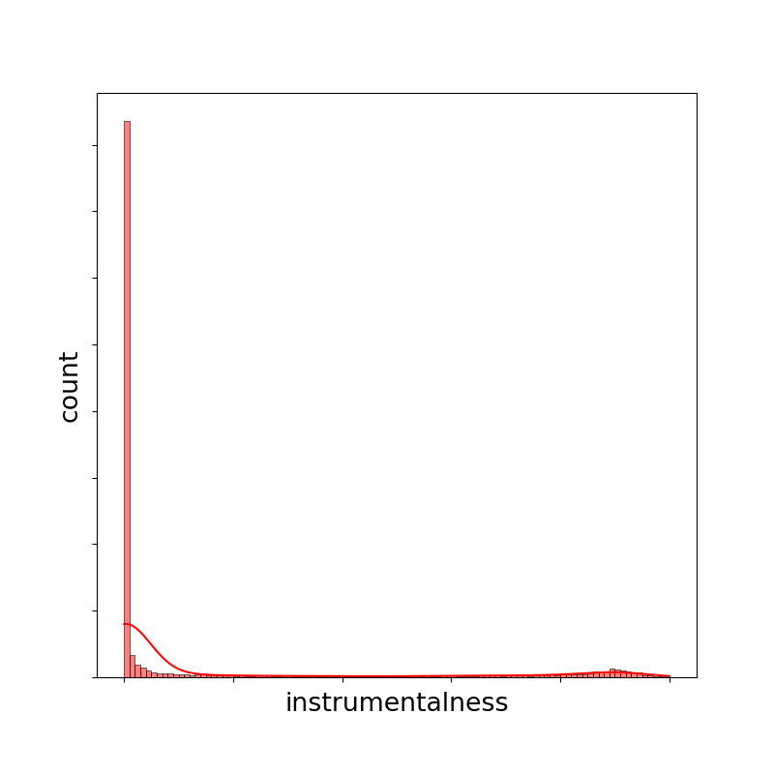
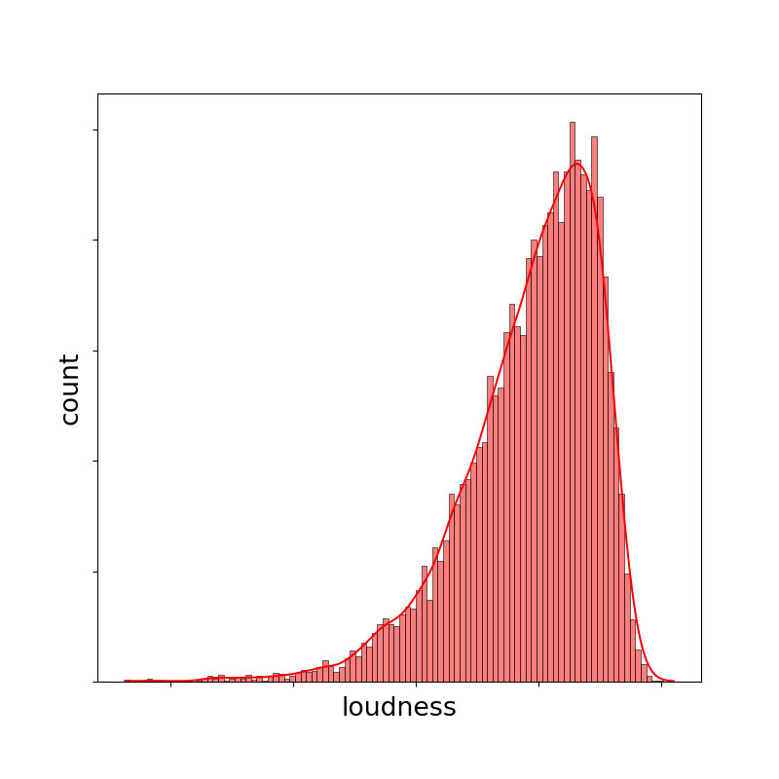
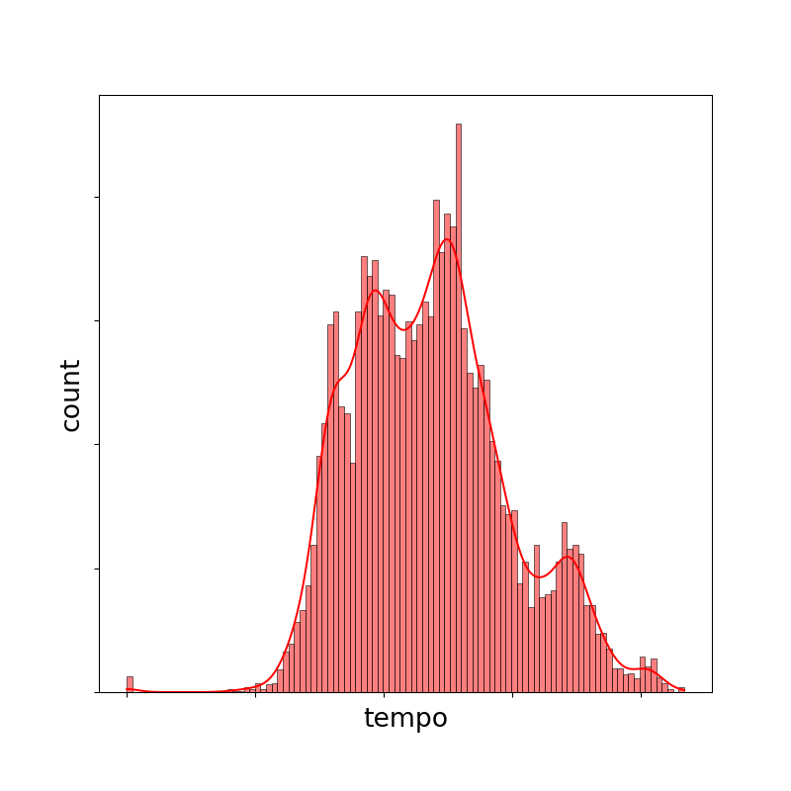
4. Histograms of features

Slide 23
5. Classification Report of Random Forest
Confusion Matrix
The F-1 score of the model 0.57
The recall score of the model 0.56
2516 | 303 | 97 | 291 | 15
310 | 2215 | 558 | 31 | 4
77 | 1077 | 1309 | 449 | 0
36 | 353 | 609 | 1501 | 107
9 | 11 | 13 | 206 | 109
Class | Precision | Recall | f1-score | support
1 | 0.85 | 0.78 | 0.82 | 3222
2 | 0.56 | 0.71 | 0.63 | 3118
3 | 0.51 | 0.45 | 0.48 | 2912
4 | 0.61 | 0.58 | 0.59 | 2606
5 | 0.51 | 0.35 | 0.42 | 369
 | Precision | Recall | f1-score | Support
macro average | 0.61 | 0.57 | 0.58 | 12227
weighted average | 0.63 | 0.63 | 0.63 | 12227

